Slide 1

BANGABANDHU SHEIKH MUJIBUR RAHMAN DIGITAL UNIVERSITY, BANGLADESH
Course Code: PROG302
Course Title: Advanced Programming with Python and Scripting Sessional
Presentation Title: Blog Application Using Django With Statement Analysis
Prepared By:
Instructed By:
Mobashira Mehajabin Arpita (ID: 2101008)
Rupu Rani Ghosh (ID:2101010)
Mehrin Farzana (ID: 2101013)
Departmentof IRE, BDU
BangabandhuSheikh Mujibur Rahman Digital University, Bangladesh
Farzana Akter
Assistant Professor
Departmentof IRE, BDU
BangabandhuSheikh Mujibur Rahman Digital University, Bangladesh

Slide 2

PRESENTATION OUTLINE
1
Introduction
2
Technologies and Tools
3
Core Functionalities of the Blog Platform
4
Watching our comments sentiment
5
Reviewing blogs comments
6
Conclusion
1

Slide 3
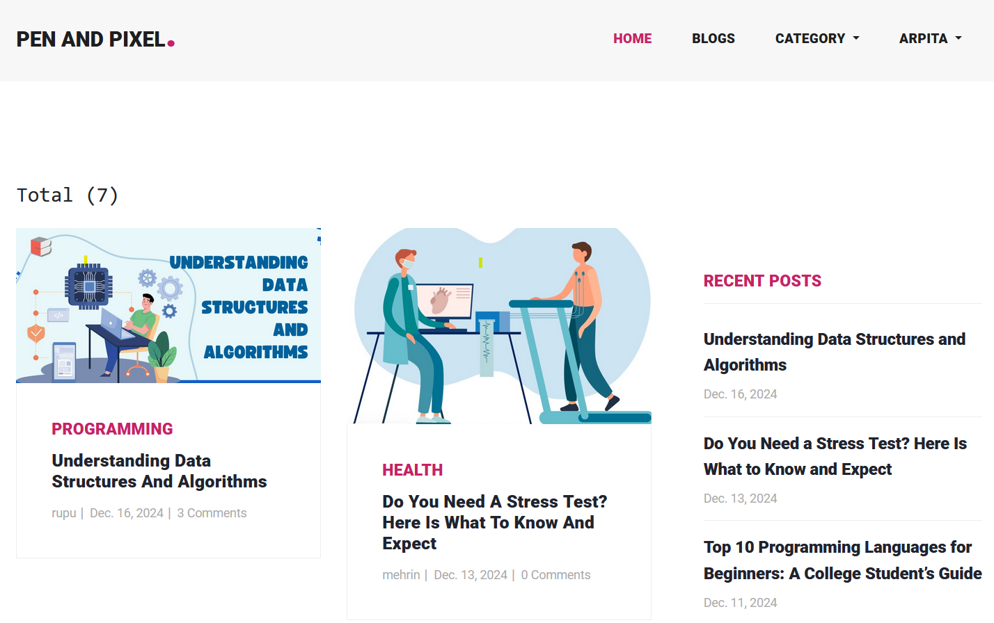
INTRODUCTION
The Blog Application project leverages Django to create a user-friendly platform for writers and readers. It features tools for managing blog posts, a commenting system, and sentiment analysis on reader feedback to provide authors with insights. The application ensures accessibility with a responsive interface across devices.
2

Slide 4
TECHNOLOGIES AND TOOLS
Frontend Technologies
HTML5, CSS3, JavaScript: Core web technologies for rendering and styling the pages
Bootstrap: For designing a responsive user interface.
JavaScript : For adding interactive features like comment submission without reloading the page.
3

Slide 5
TECHNOLOGIES AND TOOLS
Backend Technologies
Python: The core programming language used for writing the business logic of the application.
Django: The web framework used for the backend.
NLP Tools: Pre-trained sentiment-analysis pipeline from Hugging Face
Transformers.
Database: To store User, Category, Blog, Comment, Reply.
4

Slide 6
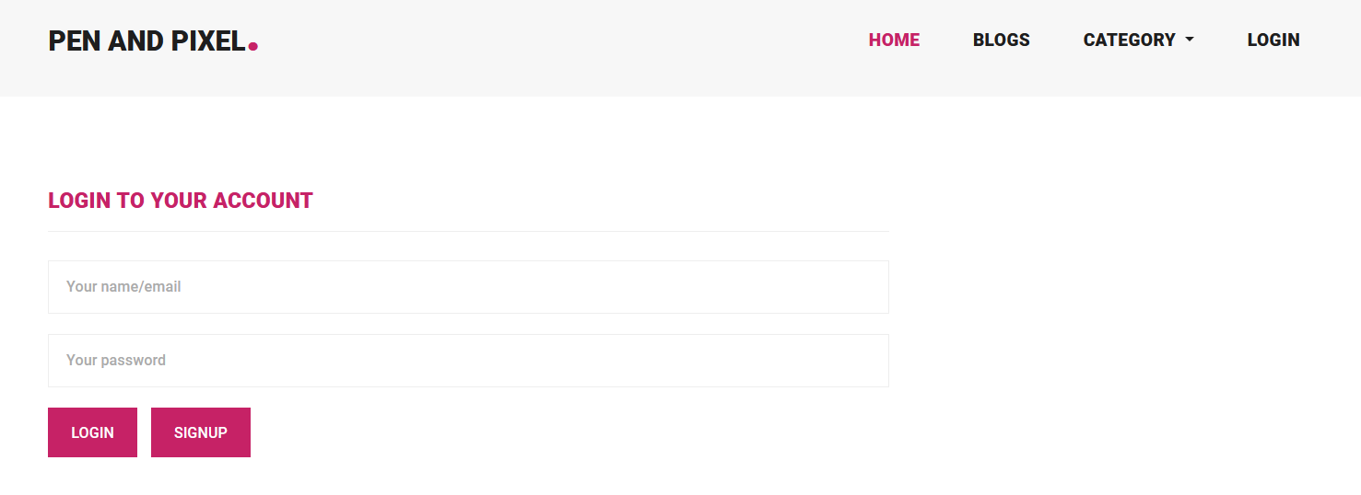
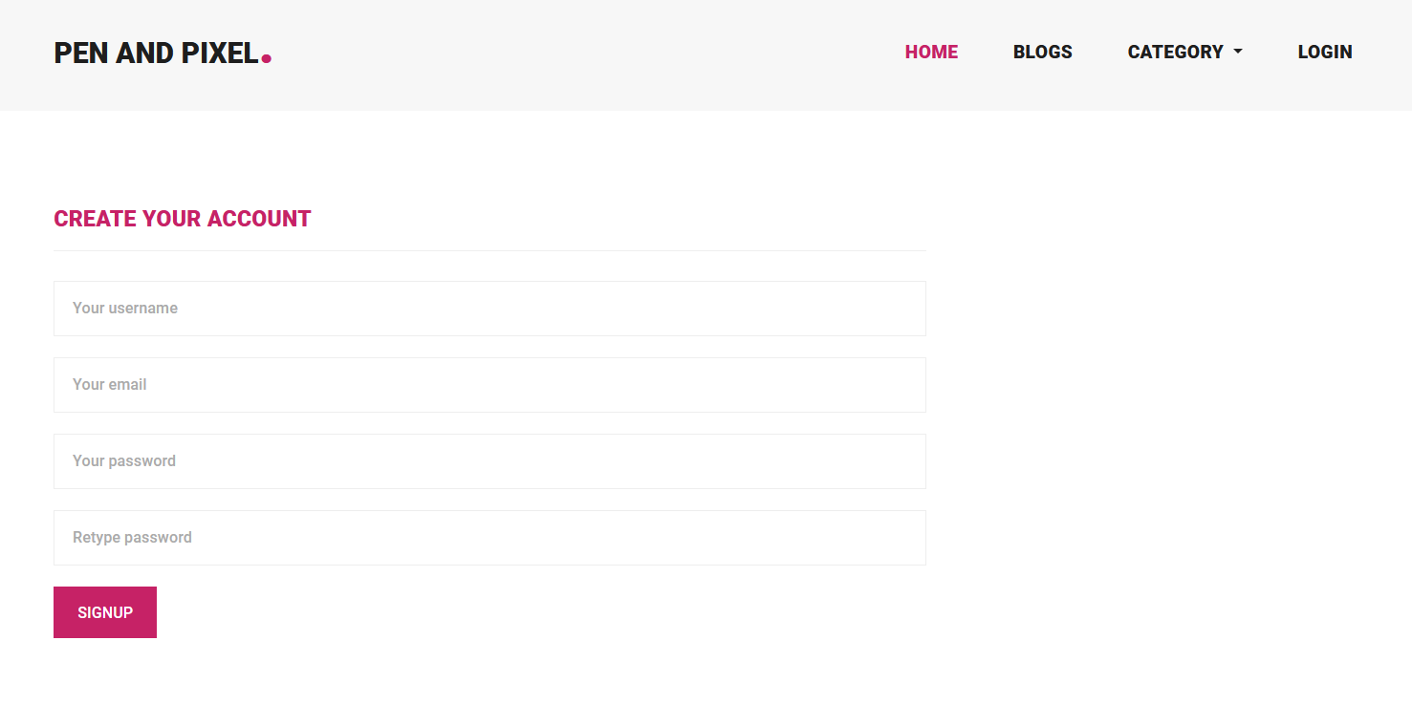
CORE FUNCTIONALITIES OF THE BLOG PLATFORM
User Authentication: Secure user registration, login, logout functionalities.
5

Slide 7
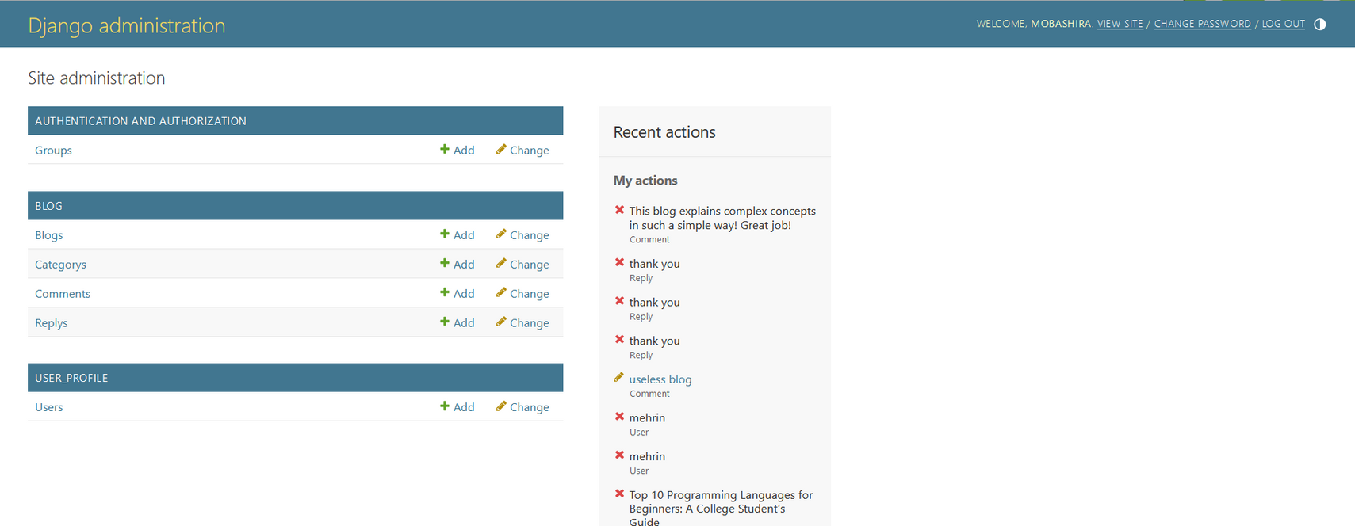
CORE FUNCTIONALITIES OF THE BLOG PLATFORM
Admin Panel: Manage posts, users, comments, and categories through Django’s admin interface.
6

Slide 8
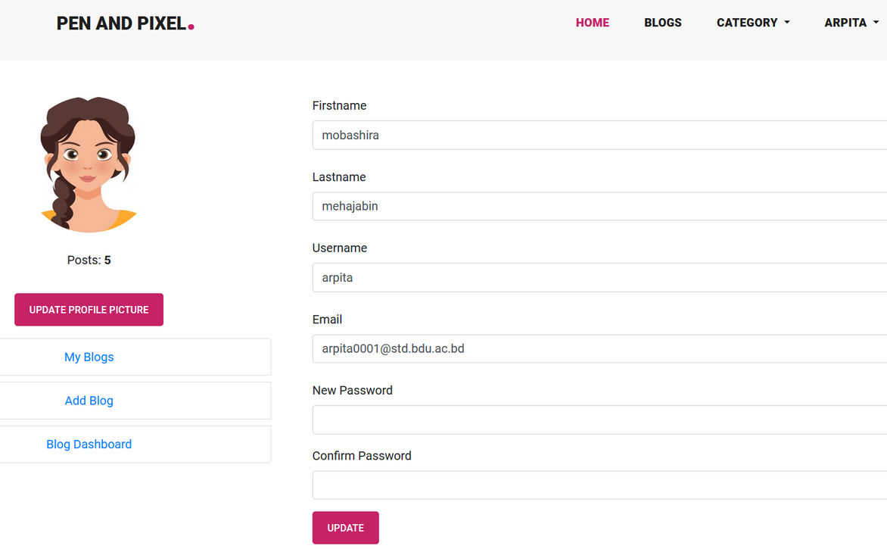
CORE FUNCTIONALITIES OF THE BLOG PLATFORM
Blog Post Management: Authenticated users can create, edit, and delete their blog posts using a rich text editor & reset password.
7

Slide 9
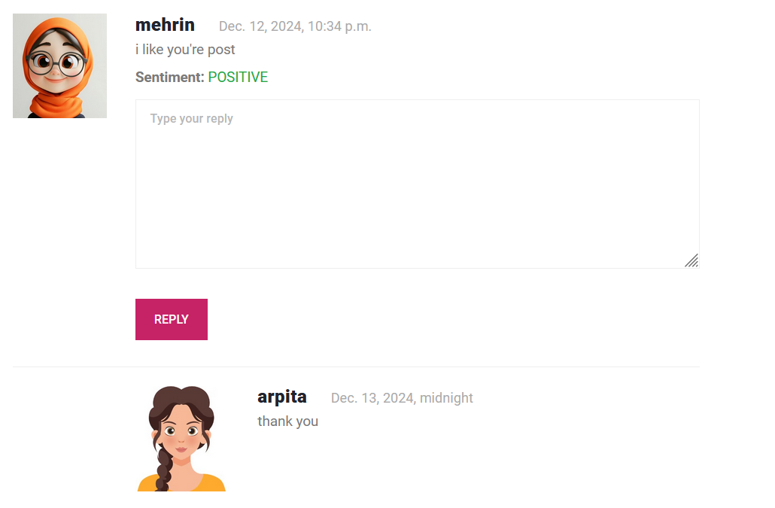
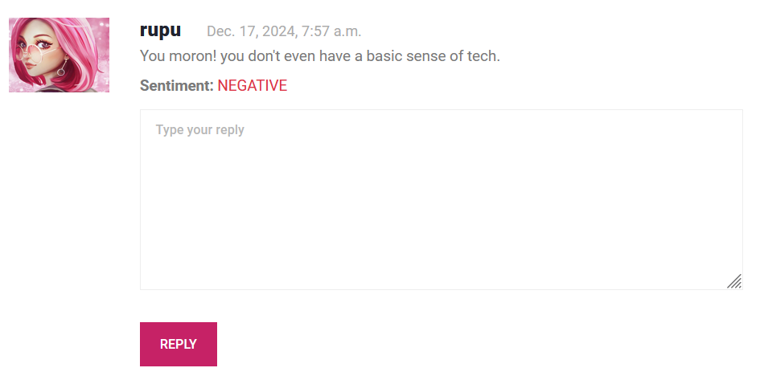
CORE FUNCTIONALITIES OF THE BLOG PLATFORM
Sentiment Analysis on Comments: Display the sentiment of comments (e.g., "Positive," "Negative") t
8

Slide 10
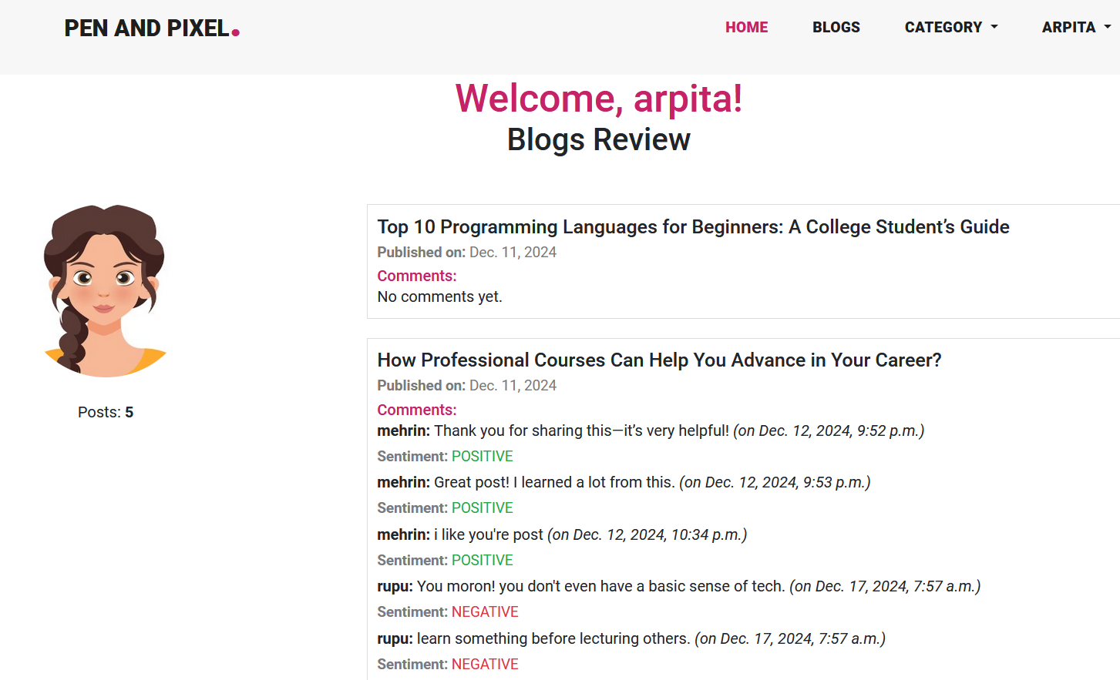
REVIEWING BLOGS COMMENTS
9

Slide 11
CONCLUSION
This project successfully delivered a comprehensive blog application built using Python Django. The platform not only met its objectives of providing core blogging functionalities but also elevated user engagement through the integration of sentiment analysis using Hugging Face Transformers. By leveraging modern front-end and back-end technologies, the application offers a secure, interactive, and user-friendly experience for bloggers and readers alike. The addition of a responsive design ensures accessibility for all users, regardless of their device. This project lays a strong foundation for further enhancements, such as real-time notifications, advanced analytics, and multimedia content support, to further enrich the blogging experience.
10

Slide 12


